Slide 1
Fantastic Fungi
Team Members:
JuanCarlos Jimenez
Nolan McCarter
Matthew Rossi

Slide 2

Phantastic Fungi
Team Members:
JuanCarlos Jimenez
Nolan McCarter
Matthew Rossi

Slide 3
Contents
01
03
02
Constraints
The Idea
Functionality & Requirements

Slide 4
01
The Idea
Notes:
Matthew will take this whole section

Slide 5
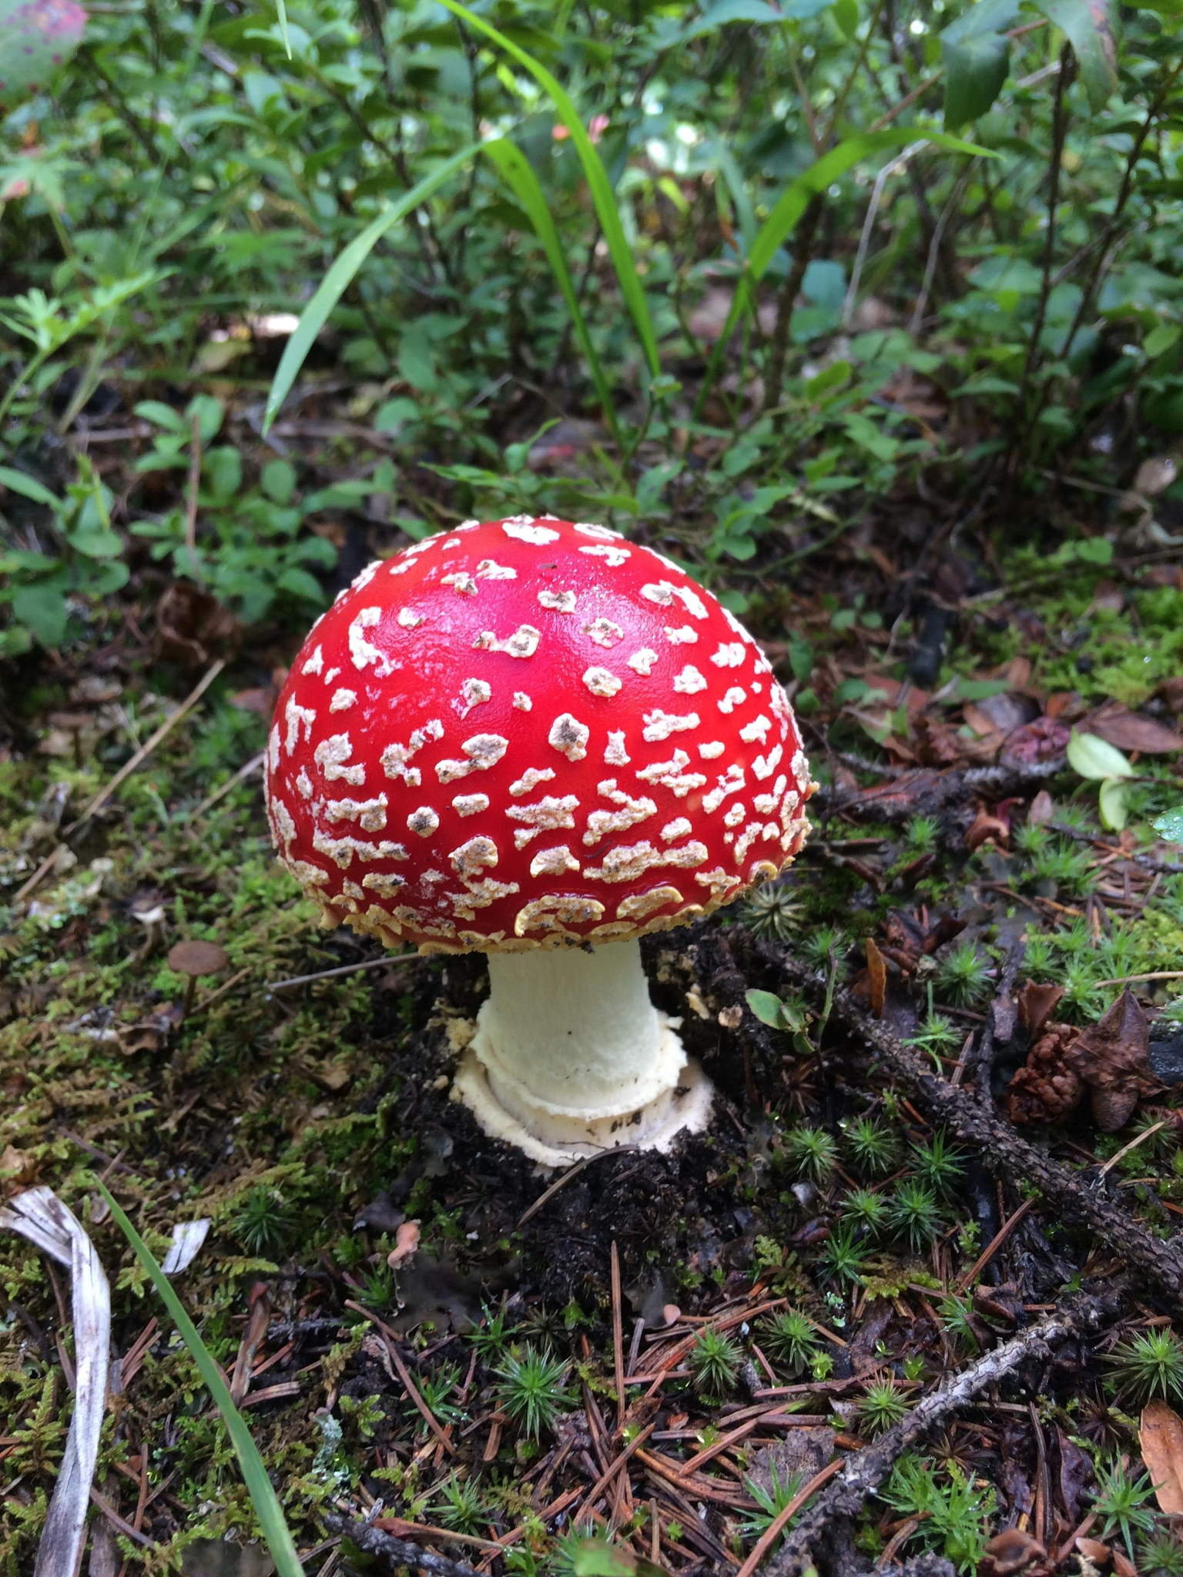
What kind of mushroom is this?
Notes:
Ask if anyone can identify it.
Does anyone know if it’s safe to eat?
This is Amanita Muscaria, a toxic mushroom.

Slide 6
The Solution: Phantastic Fungi
Upload a Photo from any device
Let our Computer Vision models work their magic
Receive information about any mushroom

Slide 7
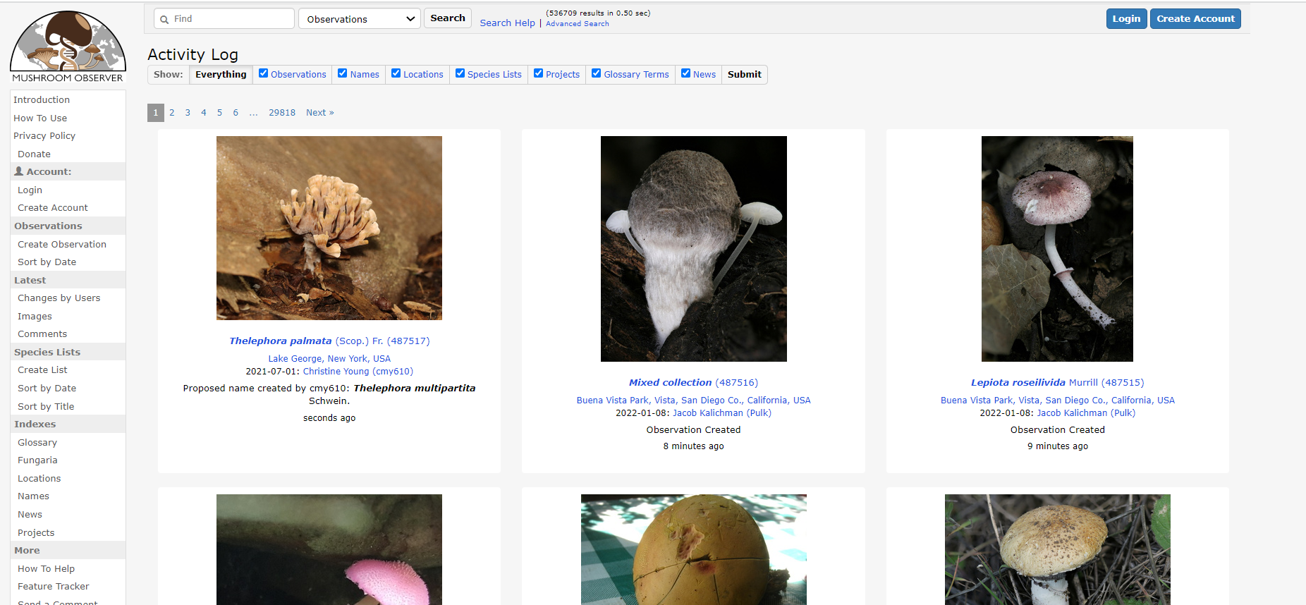
mushroomobserver.org

Slide 8
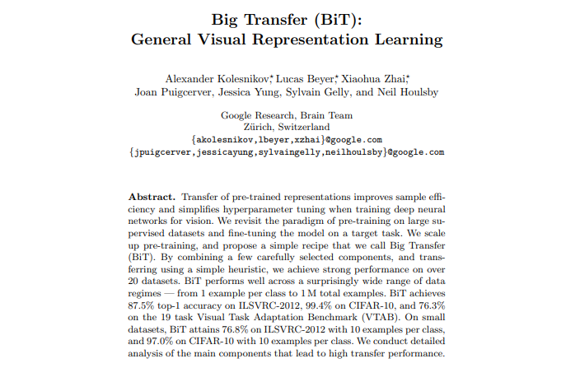

Slide 9
02
Functionality

Slide 10
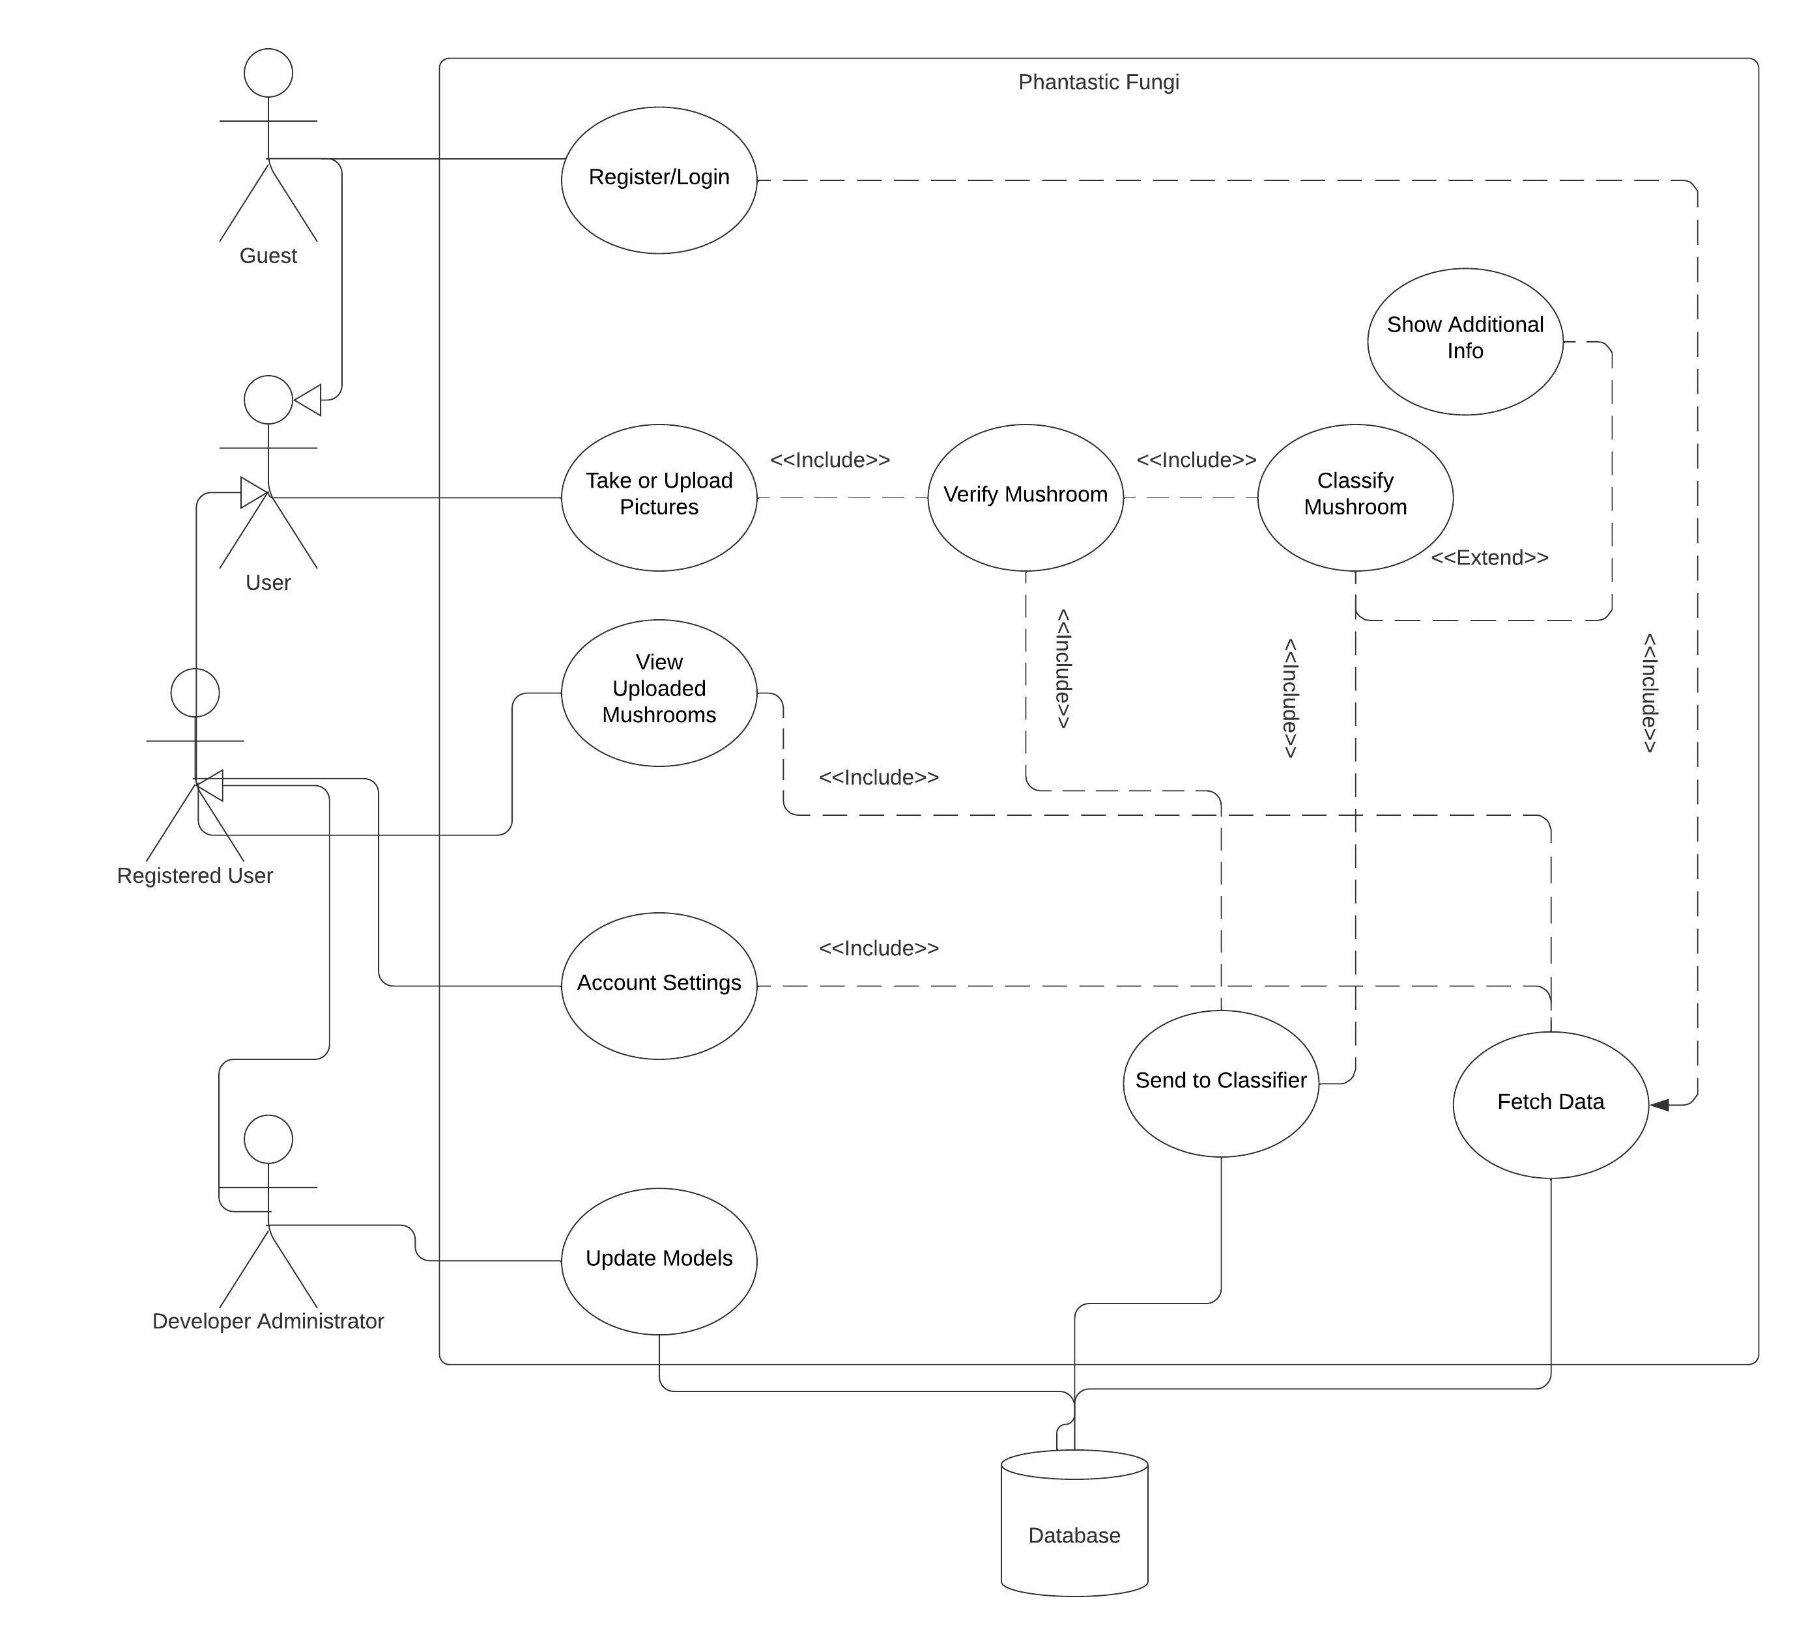
System Use-Case Diagram
Notes:
Nolan

Slide 11
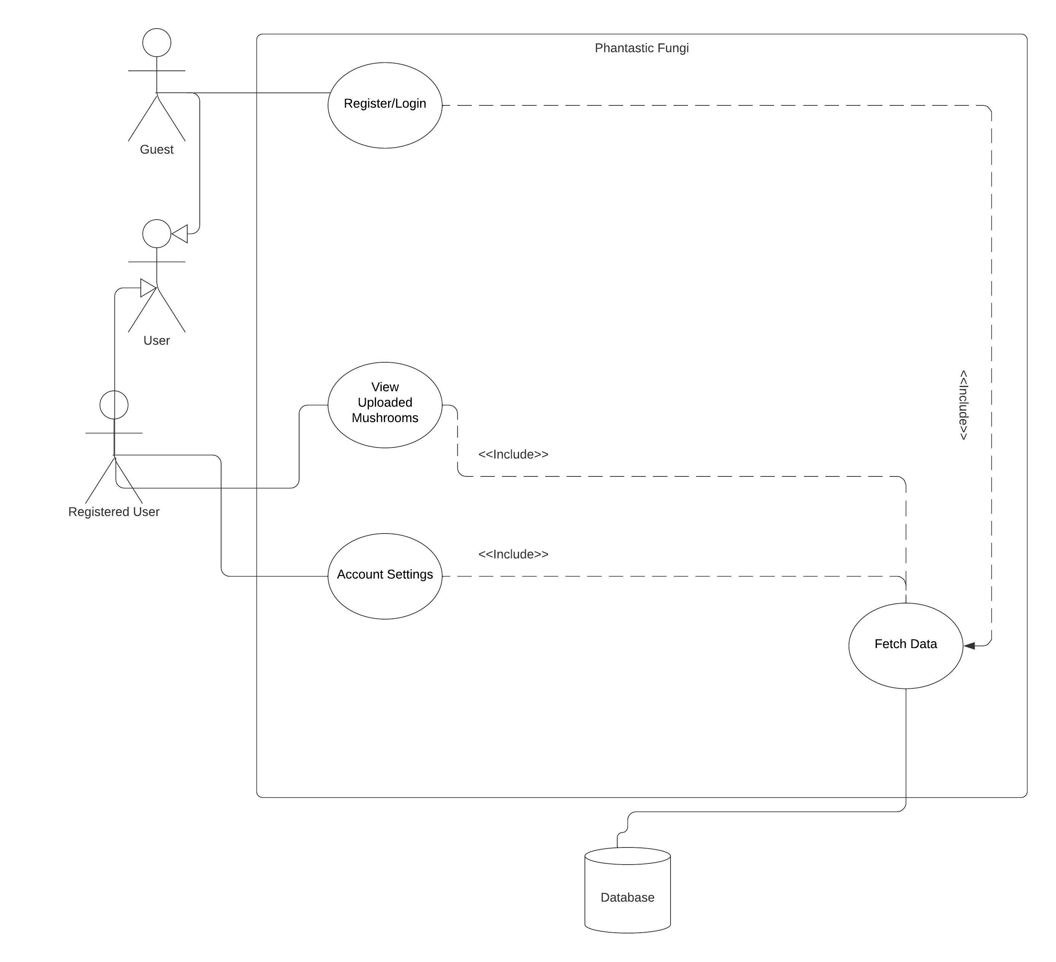
Use Case Path 1: Account Management Procedures
Notes:
(Nolan) Functional Requirements: Account sign-up, Account Login, Continue as guest, Account Settings, View my Uploads
Non-Functional Requirements: Password Encryption, Automated Password Recovery Emails

Slide 12
FR 1: Account Sign-Up
Guest users can create a new account.
Guest provides Name, Username/Email, and Password.
Upon successful account creation, guest is directed to login page.
Notes:
Nolan

Slide 13
Password Encryption
Non-Functional Requirement:
Passwords shall be encrypted before being stored in the database.
Notes:
JC

Slide 14
Automated Password Recovery Emails
Non-Functional Requirement:
Emails for password resets should be sent automatically upon user request.
Notes:
JC

Slide 15
FR 2: Account Login
Guest users can login by entering
Username/Email and Password
System validates account information against the database
Successful login takes user to home page
Notes:
Nolan

Slide 16
FR 3: Continue as Guest
Guest users can skip login and go straight to homepage, where they can access the primary functionality of the app.
Notes:
Nolan

Slide 17
FR 4: Account Settings
Verified users can change the following settings:
Account info (username, password, email)
Share uploaded images to database (default: OFF)
Share location data (default: OFF)
Users can save or discard their changes.
Users can also log out from the settings page.
Notes:
Nolan

Slide 18
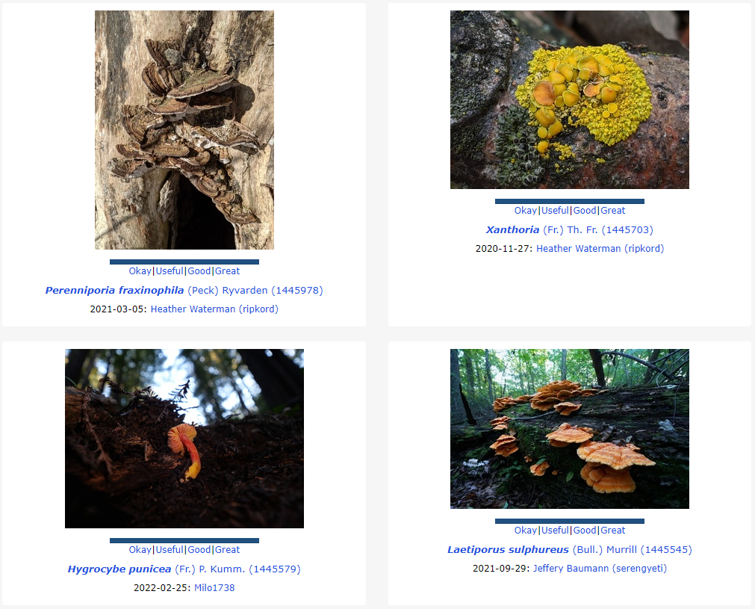
FR 5: View My Uploads
Verified users can view the images they have uploaded, including the predicted classification.
Notes:
Nolan

Slide 19
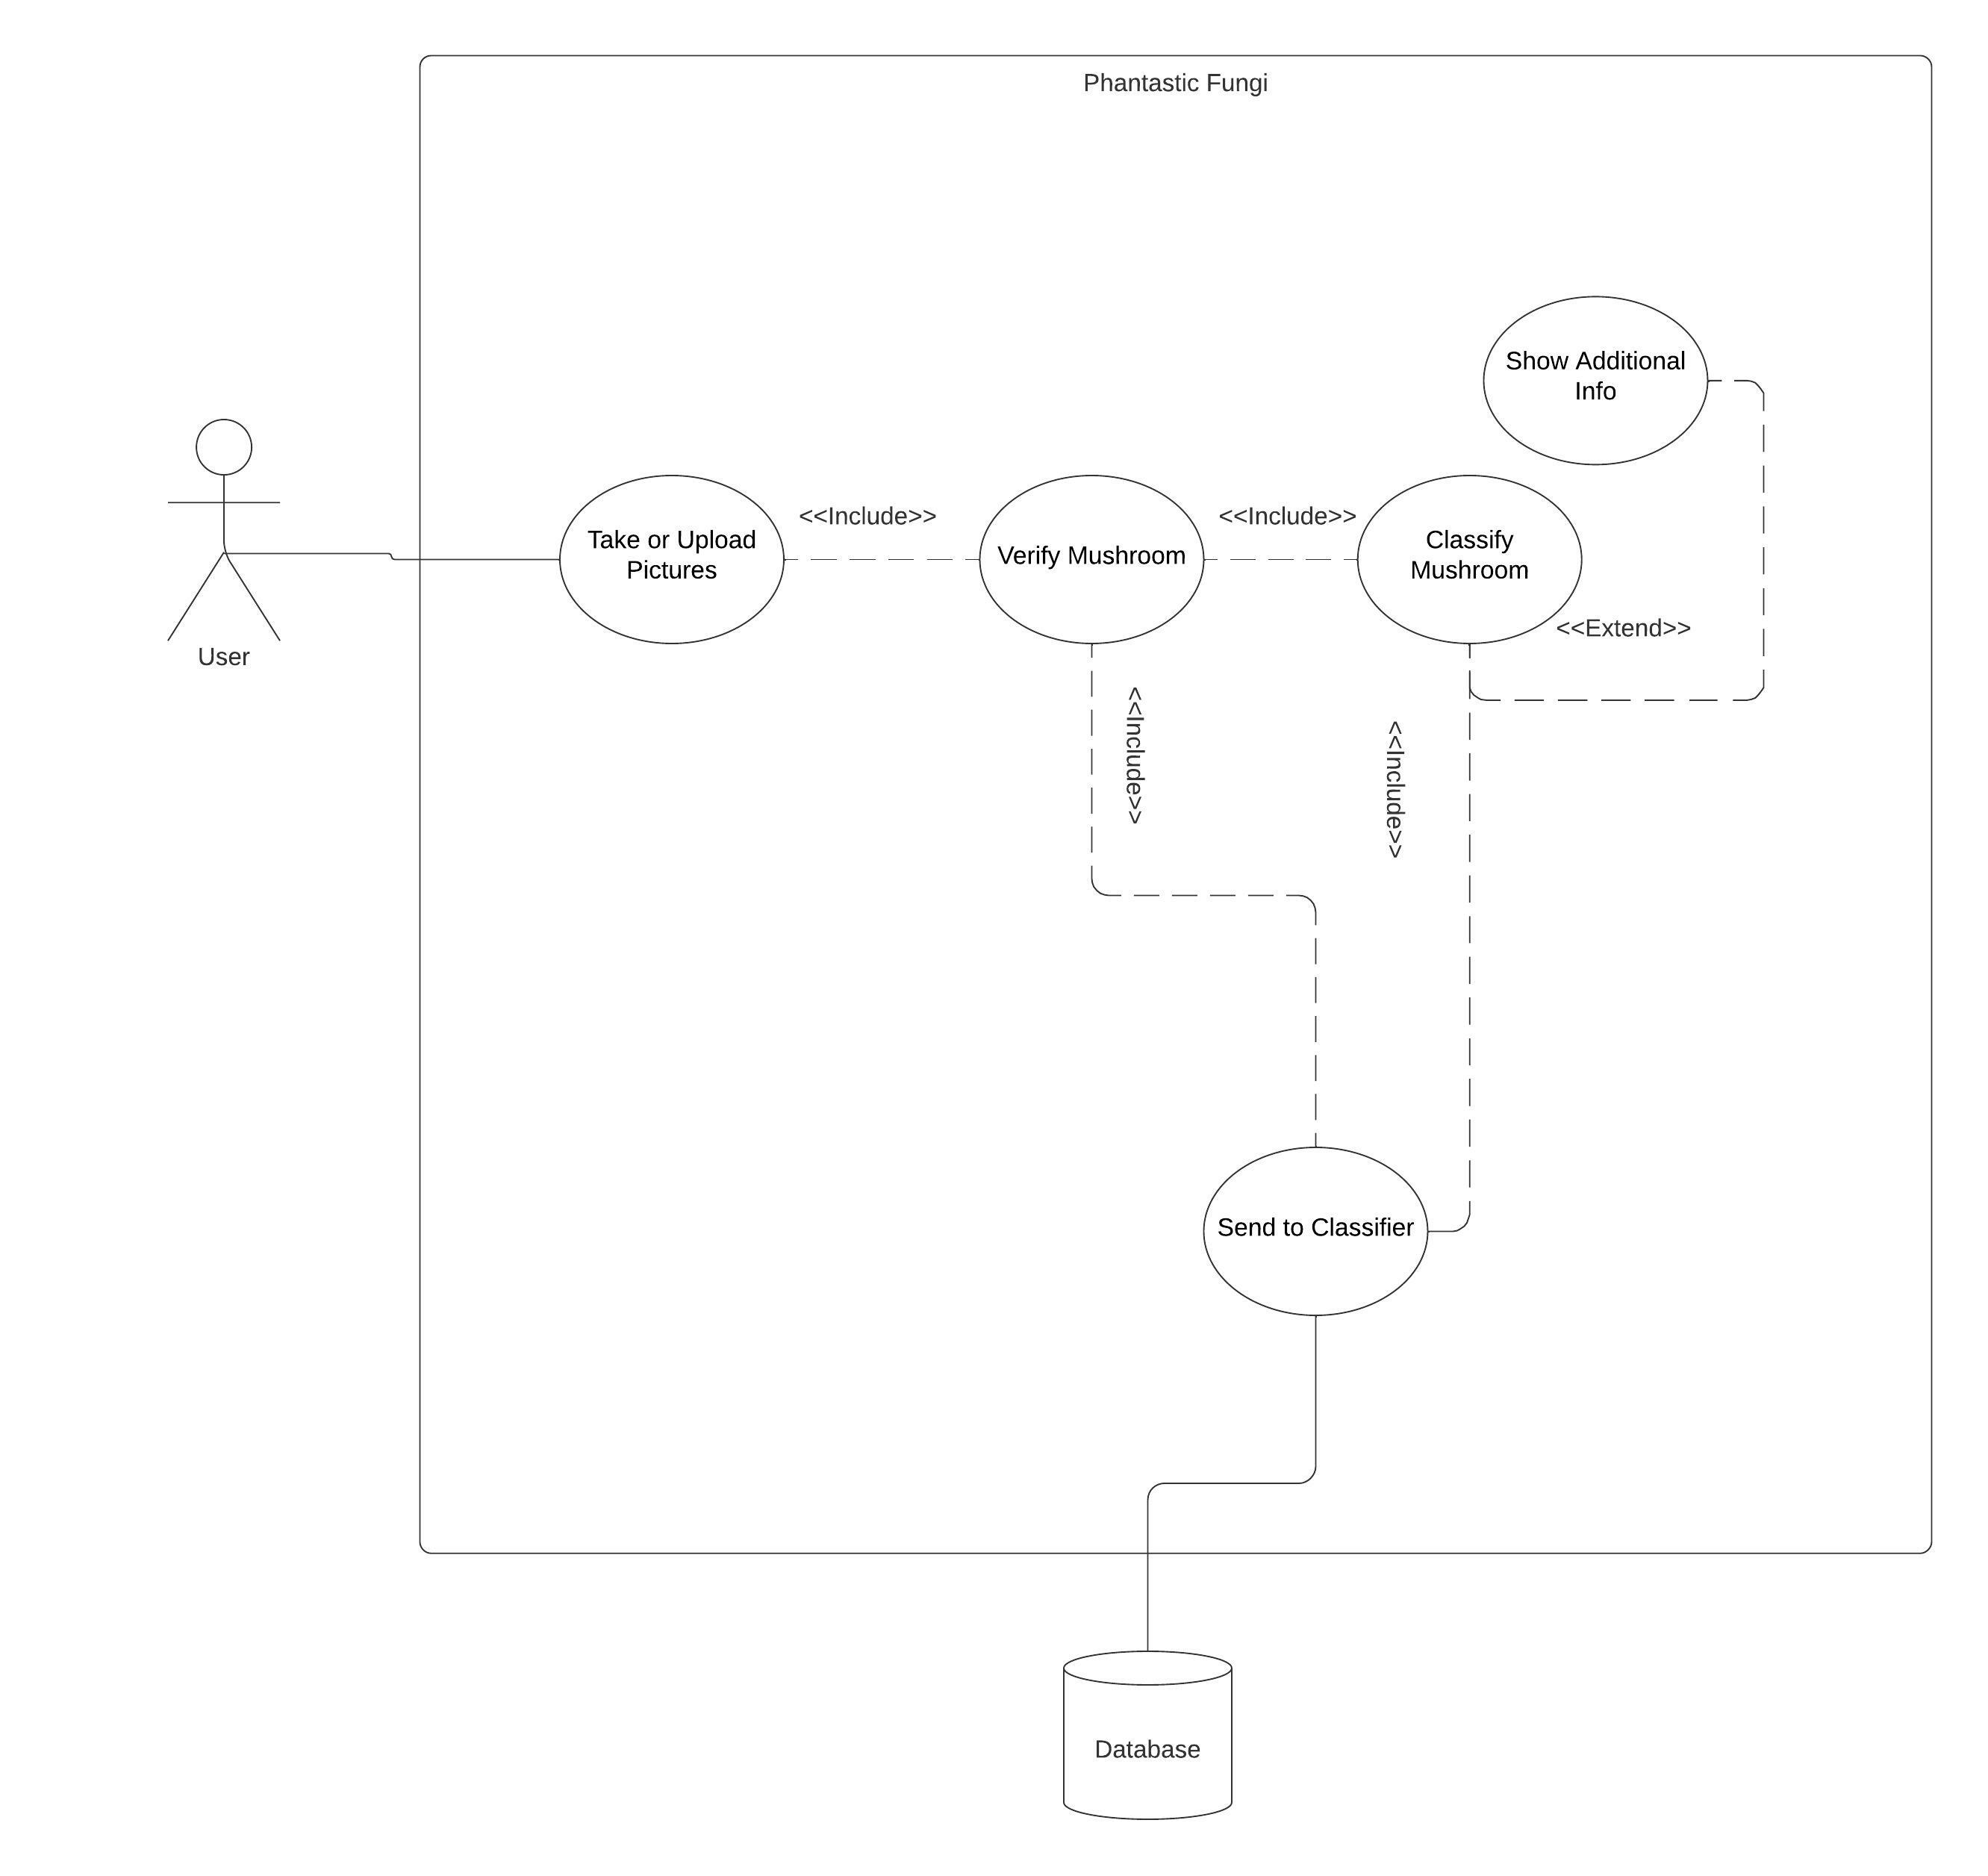
Use Case Path 2: Classify Mushroom
Notes:
(JC) Functional Requirements: Take Picture, Upload Picture, Verify Mushroom Presence, Classify Mushroom, View my Uploads, Show additional Info
Non-Functional Requirements: Inference Time

Slide 20
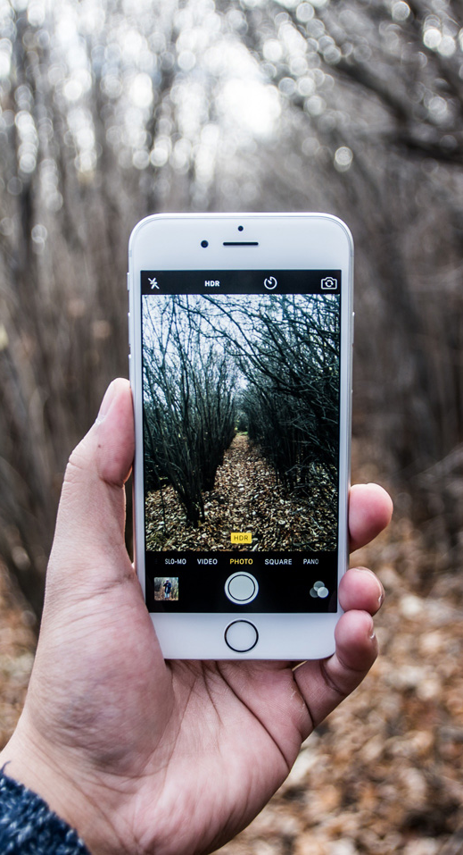
FR 6: Take Picture
User must have logged in or selected to continue as guest.
Must enable access to the camera.
User must confirm that they want to submit this picture for classification.
Notes:
JC

Slide 21
FR 7: Upload Picture
User clicks “Upload Picture”.
User selects a picture from camera roll.
User confirms that they want to submit this picture for classification.
Notes:
JC

Slide 22
FR 8: Verify Mushroom Presence
App tells user whether the picture is predicted to contain a mushroom or not.
If it isn’t a mushroom, it will suggest the user takes/uploads another picture, with an option to override and proceed with classification anyway.
Notes:
(JC) Uses binary classifier to trained on image data to predict whether or not the image contains a mushroom.

Slide 23
FR 9: Classify Mushroom
User must provide an image that passes the mushroom verification.
Determines the genus and species of the mushroom.
Brings user to page detailing the mushroom with options to return to home page, view uploads, or view additional information.
Notes:
(JC) Uses multiclass neural network classifier trained on mushroom image data to determine genus and species

Slide 24
Associated NFR: Inference Time
5 seconds
Notes:
Nolan

Slide 25
FR 10: Extra Information
User must provide an image that passes mushroom verification and classification or viewing a previous submission from my uploads.
Brings user to a Wikipedia page on that genus and species.
Shows other pictures on mushroomobserver.org.
Notes:
JC

Slide 26
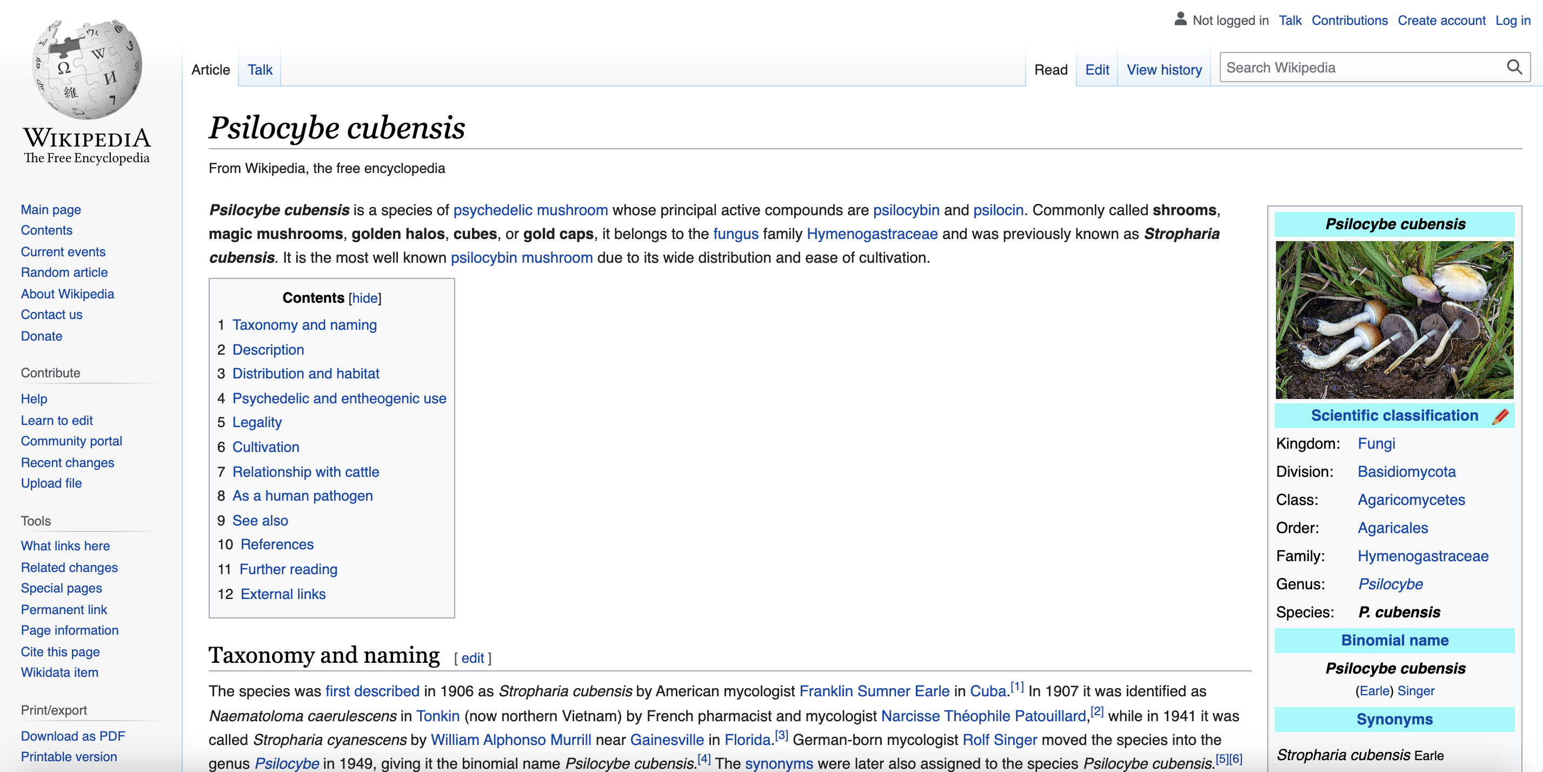

Slide 27
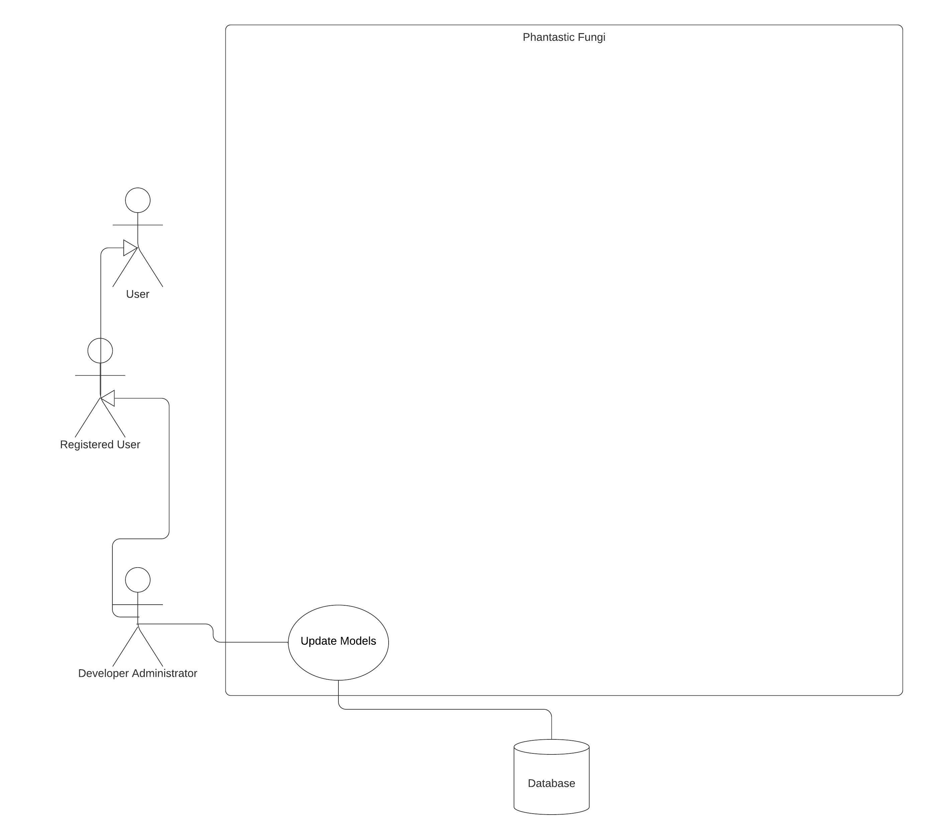
Use Case Path 3: Neural Network Management
Notes:
(Matthew) Functional Requirements: Update Model (Developer-only)

Slide 28
FR 11: Update Models (Developer-only)
Administrator/Developer users, when logged in, can upload new parameters for the neural networks.
Notes:
Matthew

Slide 29
Non-Functional Requirement:
Model Replacement Downtime
When a developer updates the model parameters, the app should experience no more than 5 minutes of downtime.
Notes:
Nolan

Slide 30
Non-Functional Requirement:
Uptime
The application should experience no more than 5 minutes of downtime per month.
Notes:
Nolan

Slide 31








ER 1: Random Mushroom
User must already have selected to continue as guest or login to account.
Selects a random mushroom from the database.
Notes:
JC

Slide 32
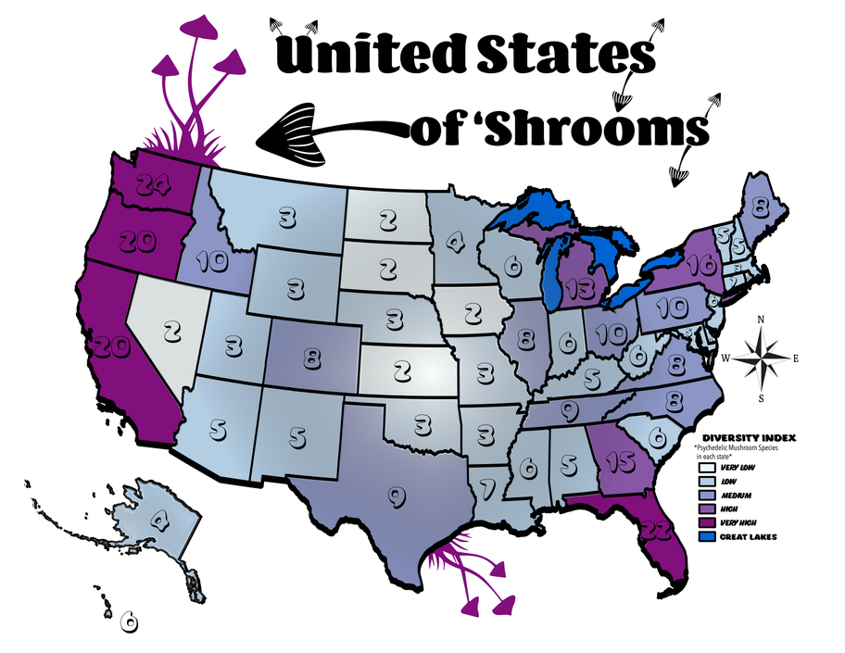
ER 2: Location Data
Location data can help improve the quality of predictions.
Notes:
JC

Slide 33
03
Constraints
Notes:
Matthew will take this whole section

Slide 34
Deployment Constraints
Platform
Web Framework
Web Server
Intended for use as a mobile application.
Protocols for interactions between client and database.
Database host.

Slide 35
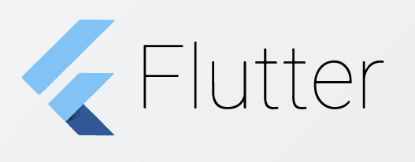


Potential Deployment Solutions
Platform
Web Framework
Web Server
Notes:
Flutter, from Google, is a development framework for building platform-independent apps.
Django is a python-based web framework that we can use to build our backend.
Amazon Lightsail provides web hosting, and offers a 3-month free trial.

Slide 36
Language Constraints
Frontend (UI)
Backend
Neural Networks
Flutter uses the Dart language.
Django is entirely Python based.
The neural networks from Big Transfer are written in Python.

Slide 37
Storage Constraints
User account information
Name, Username/Email, Encrypted Password
Account settings
Uploaded images
Neural Network Parameters
Binary classifier to verify mushroom presence
Genus/species classifier

Slide 38
Computation Constraints
The server needs enough compute power to perform inference with the neural networks.

Slide 39
Network Constraints
Client Internet Access
Database Access
Store/retrieve user account information
Send image for inference
Without internet service, the application’s functionality is not accessible to the user.

Slide 40
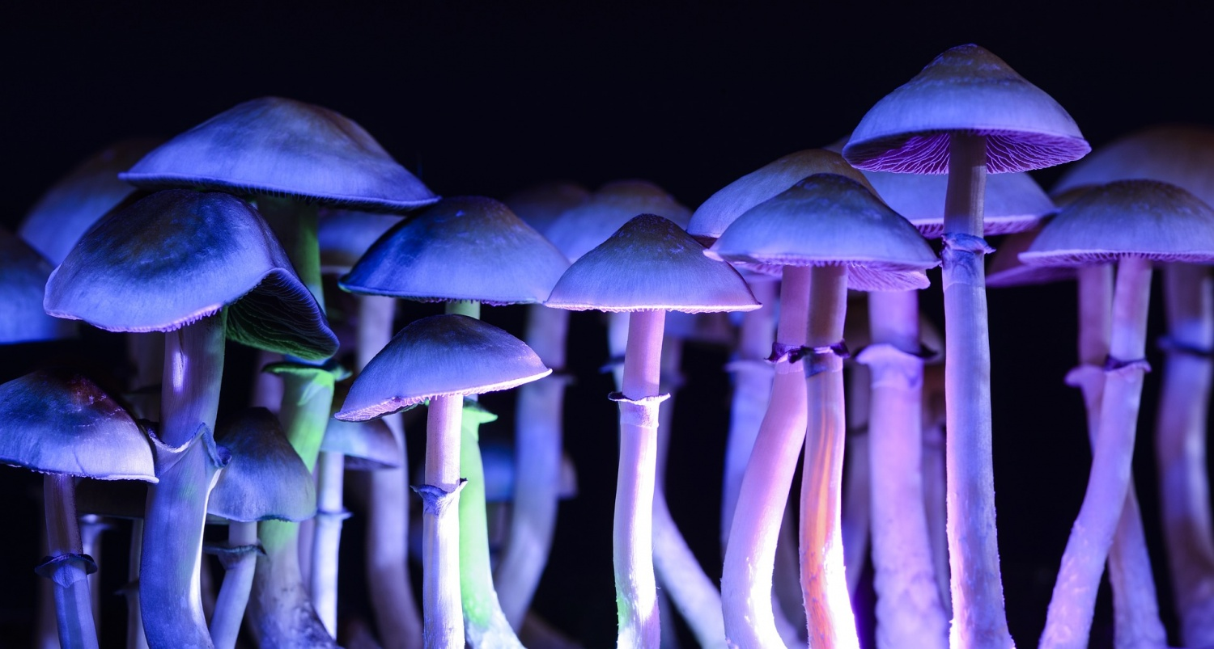
Thanks!

